Slide 1


Introduction
GenDF:
A Modular Framework
for Evaluating Generalization and Adaptability
in Deepfake Detection
Student Name: Ms. Kavini Fernando
Student ID : w1833630 / 20200760
Mentor: Ms. Kalhari Walawage

Slide 2


Agenda
Problem Background
Research Gap and Objectives
Project Aim
The GenDF Framework
System Architecture
Implementation- Technology Stack
Demonstration of the software
Testing and Evaluation
Novelty
Conclusion and Future Work

Slide 3

Problem Background
Deepfakes pose growing threats to trust, security, and public safety (Kietzmann et al., 2020)
Existing detection models often:
- Overfit to specific datasets (Dong et al., 2023)
- Fail to generalize to unseen forgeries (Tolosana et al., 2020)
- Struggle against evolving deepfake generation techniques (Verdoliva, 2020)
Static augmentations and rigid pipelines limits adaptability to real-world data (Guarnera et al., 2022; Haliassos et al., 2022)

Slide 4

Research Gap and Objectives
Static pipelines lack adaptability to diverse forgery types
(Guarnera et al., 2022)
→ motivated the use of Reinforcement Learning for dynamic augmentation
Detection models fail to generalize across datasets
(Tolosana et al., 2020)
→ motivated the use of Contrastive Learning for identity-invariant feature learning
Limited use of adaptive learning during training and inference
(Verdoliva, 2020; Dong et al., 2023)
→ motivated the use of Test-Time Training for real-time domain adaptation

Slide 5
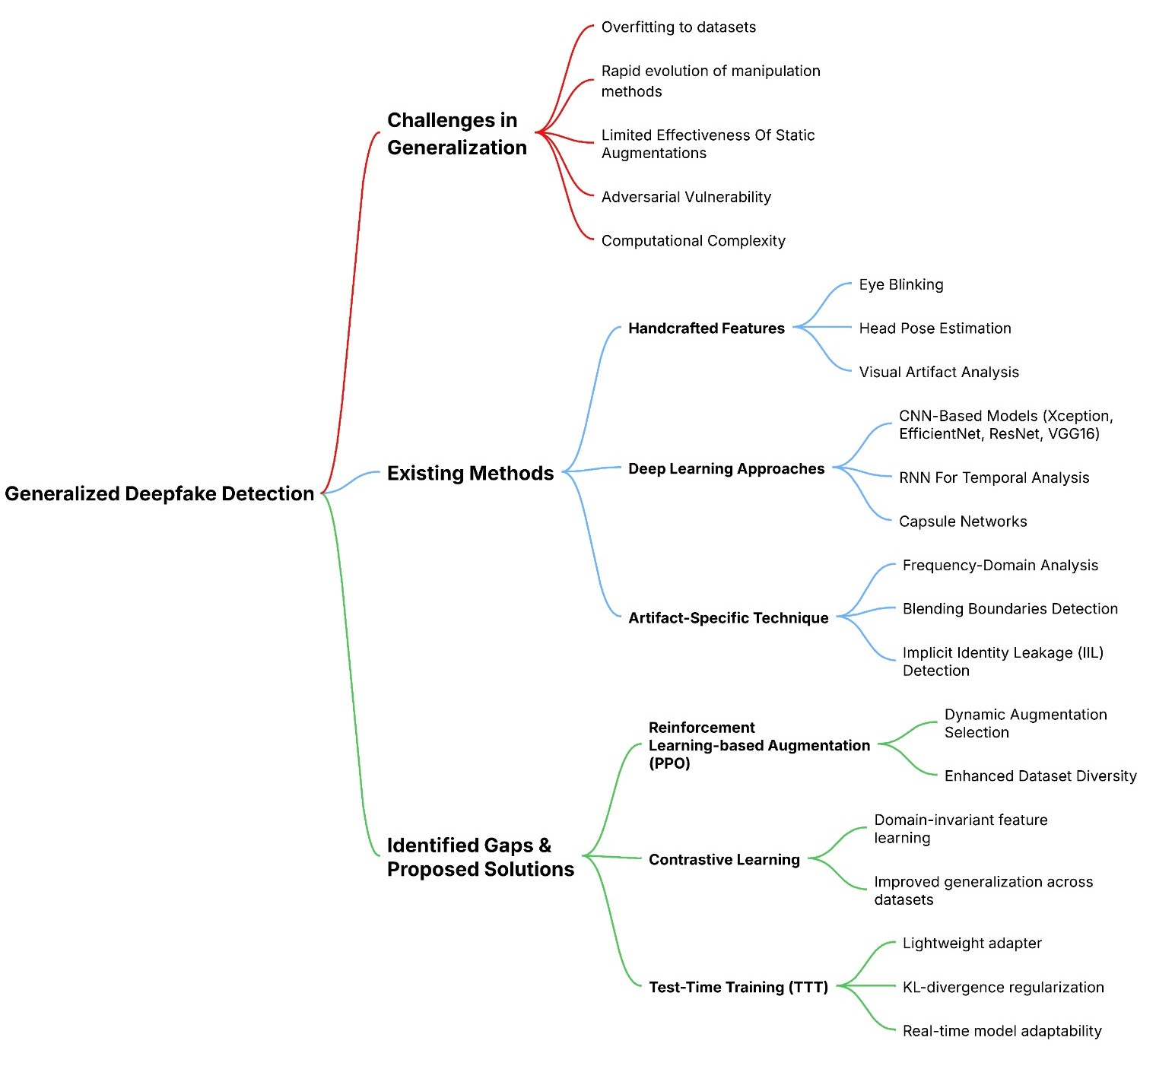

CONCEPT MAP
Research Gap and Objectives

Slide 6

Project AIM
The aim of this research project is to design, develop, and evaluate a modular deepfake detection framework that integrates reinforcement learning, contrastive learning, and test-time training to explore their individual and combined effects on detection generalization, adaptability, and real-world usability.

Slide 7

THE GENDF FRAMEWORK
GenDF explores the individual and combined impact of:
Reinforcement Learning (RL) – Version A
RL + Contrastive Learning (CL) – Version B
RL + CL+ Test-Time Training (TTT) – Version C
CL only version – Version D
The progressive layering technique is applied as follows,
Version A → B → C
Designed to test generalization, robustness, and explainability

Slide 8
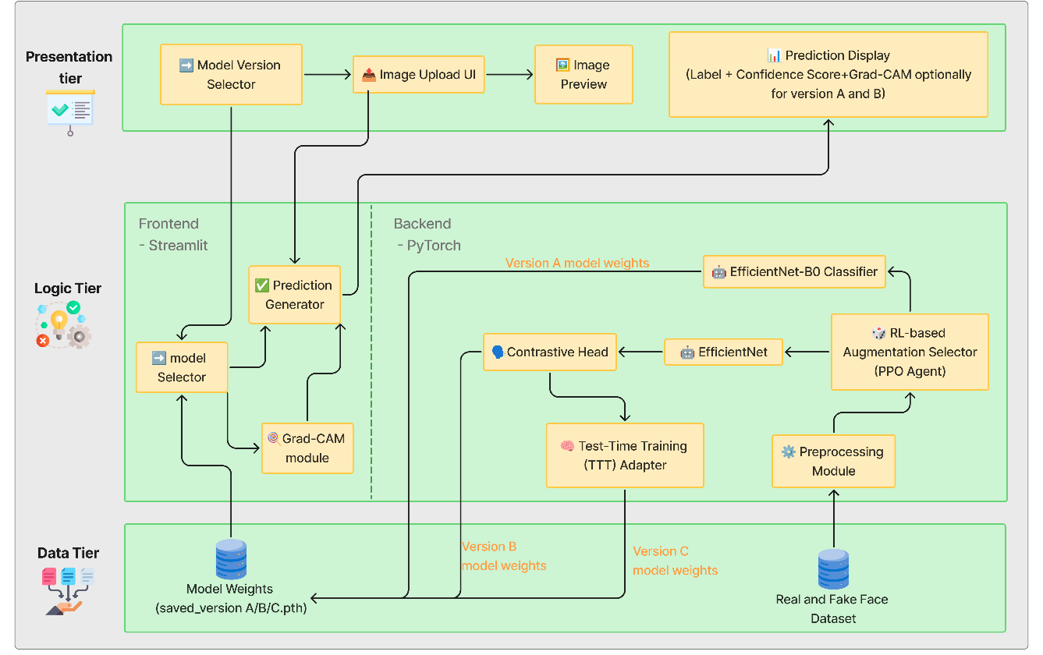
SYSTEM ARCHITECTURE
Presentation Tier: Streamlit UI for image upload, result view, Grad-CAM
Logic Tier: RL-based augmentation, EfficientNet classifier, CL and TTT modules
Data Tier: Trained model weights and input datasets
modular design supports scalable experimentation

Slide 9
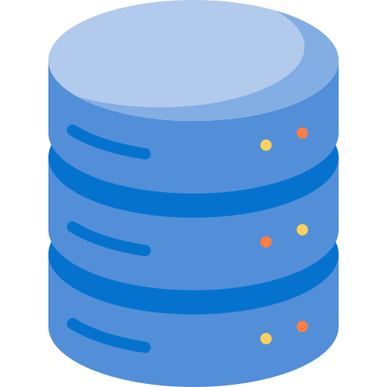
Dataset
Initial dataset exploration: Considered FaceForensics++, Celeb-DF, DFDC, and WildDeepfake Issues faced: • Video-based formats not suitable for image models • Restricted access/licensing • unclear labels
Real and Fake Face Detection
Includes 2041 images in total
1081 fake images
960 fake image
Limitation Only contains front-facing, portrait-style human faces

Slide 10
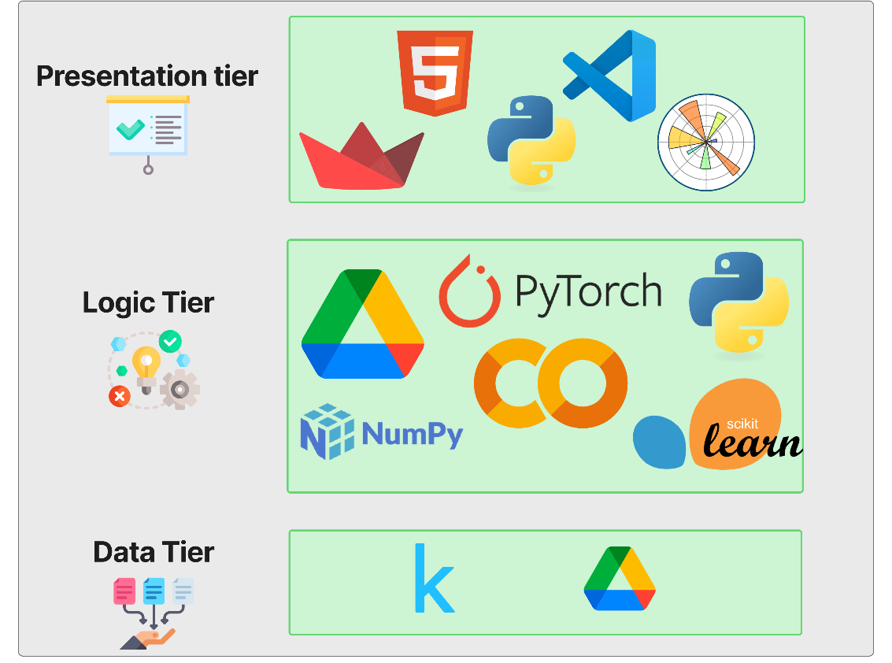
Implementation - TECHNOLOGY STACK

Slide 11

Demonstration of the software
User Interface Walkthrough
Step 1: User uploads an image
Step 2: User selects model version (Version A, B, C or D)
Step 3: Model performs inference and returns:
Prediction (Real or Fake)
Confidence score, Grad-CAM
Heatmap if selected (only for Version A, B and D)
Highlight Core Features
Modular Model Selection with dynamic version switching
Optional Explainability Overlay for interpretability (Grad-CAM)
Usability and Performance
Fast inference response
Easy-to-understand output
Built-in transparency via visual cues and confidence scores

Slide 12

Testing and Evaluation
Functional Testing
All four model versions passed unit-level functional testing
Non-Functional Testing
Performance:
A: 0.0108s
B: 0.0107s (fastest)
C: 0.0123s
D: 0.0143s
Security:
In-memory only, no storage for all models
Usability:
Grad-CAM (A, B and D) improved transparency
Interface refined via focus group
Model Testing
Version B: Best performer across all metrics
Version A & C: Showed balanced trade-offs, both with AUC = 0.85
Version D: Achieved high recall (83.56%), but had the lowest precision, indicating more false positives
Metric | Version A | Version B | Version C | Version D
Accuracy | 76.14% | 91.83% | 75.16% | 70.26%
F1 Score | 78.96% | 92.96% | 76.54% | 72.84%
Precision | 79.19% | 88.24% | 76.54% | 64.55%
Recall | 78.74% | 98.21% | 76.54% | 83.56%
AUC | 0.85 | 0.98 | 0.85 | 0.80
Table 01: Model Testing

Slide 13
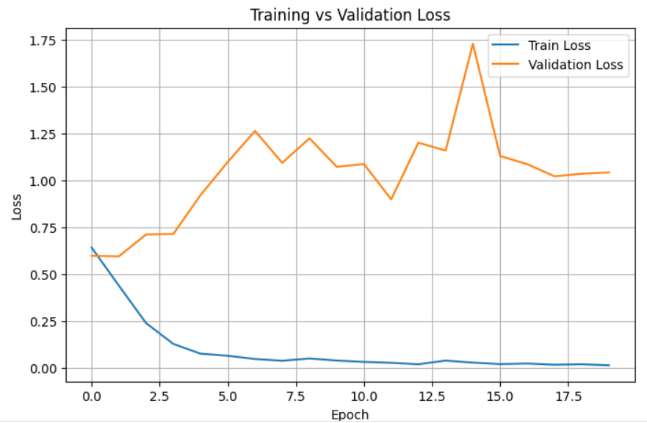
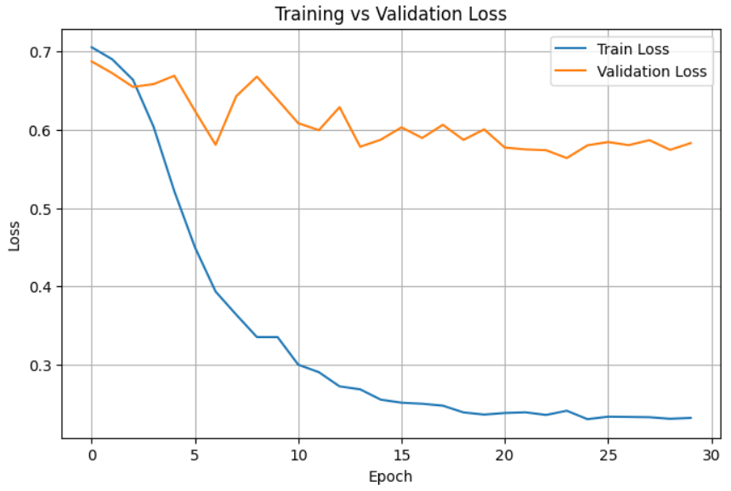
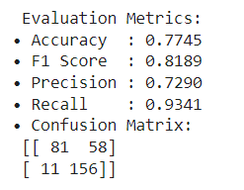
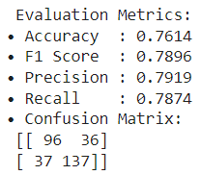
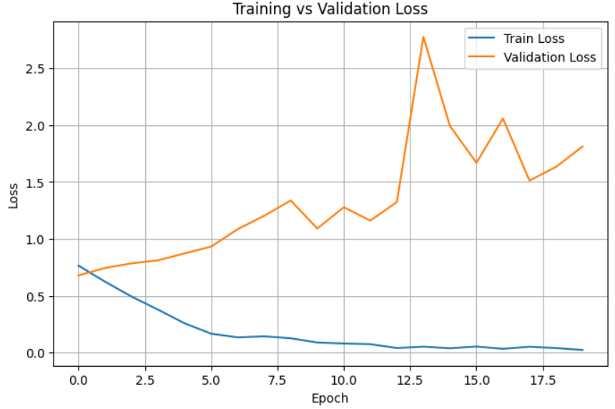
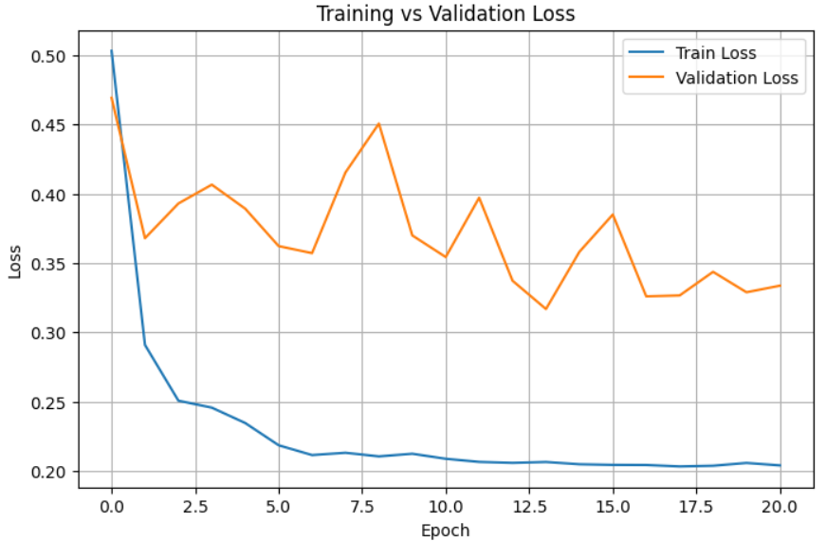
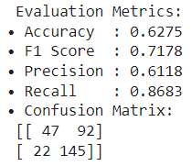
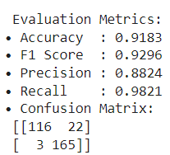
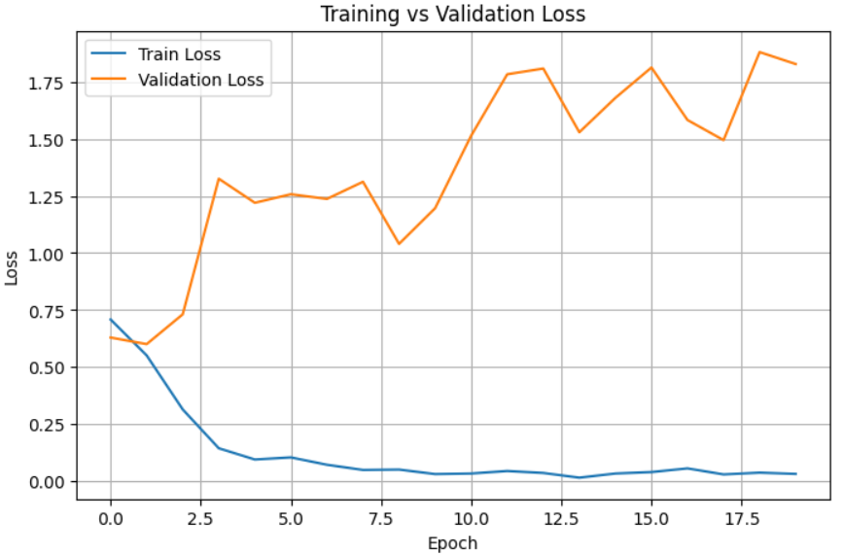
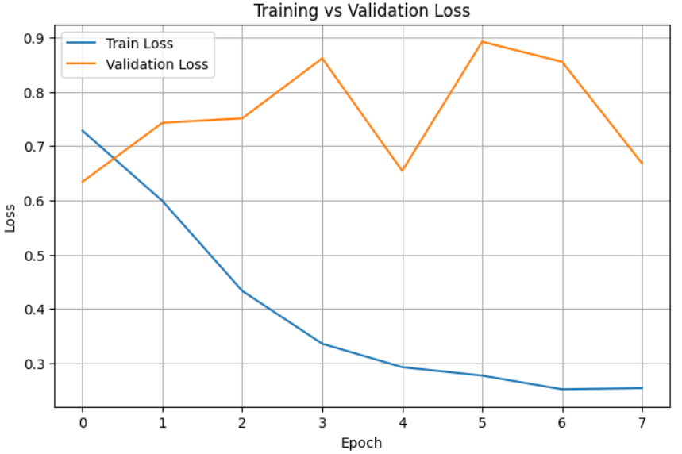
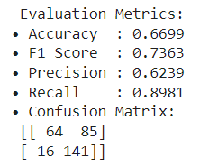
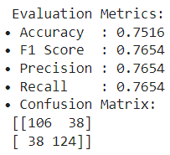
 | Before | After
A
B
C

Slide 14
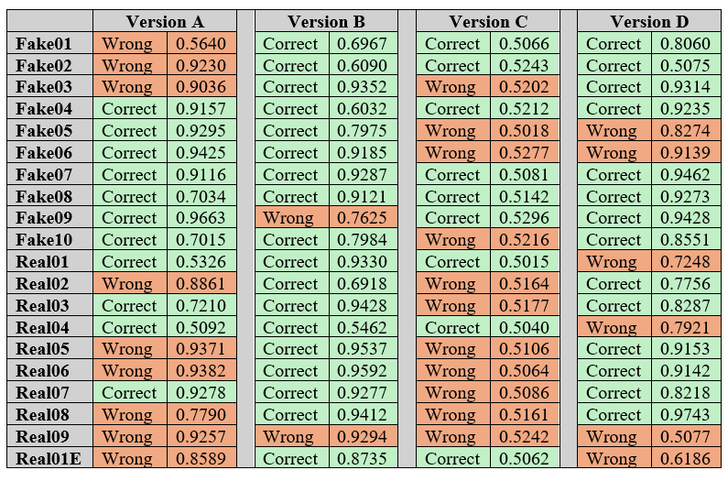
System testing
Testing and Evaluation

Slide 15
Benchmarking
Model/Study | Techniques Used | Dataset | Reported Accuracy | Notes
Korshunov & Marcel (2022) | Few-shot learning, Data Farming | FaceForensics++ | 87.6% | Strong generalization, but high computational cost
Chen et al. (2022) – OST | One-Shot Test-Time Training | Celeb-DF | 85.3% | Excellent adaptability; lacks explainability
Dong et al. (2023) – IIL Defense | Multi-scale swap, Contrastive Loss | WildDeepfake | 84.5% | Mitigates identity leakage, domain generalization focus
GenDF Version B (Proposed) | RL + Contrastive Learning + EfficientNet | Kaggle Real/Fake | 91.2% | Strong generalization in portrait-style deepfakes

Slide 16

Contribution and Challenges
Testing and Evaluation
Contribution to Body of Knowledge:
Component-wise Generalization Insights
Empirical Benchmarking
Overfitting Reduction Validation
Portrait-Style Deepfake Domain Specialization
Challenges Faced:
Severe Overfitting in Early Models
Model-Specific Limitations
Dataset Generalization Trade-Off

Slide 17

Novelty
First to integrate RL, CL, and TTT in one modular framework - a novel combination in deepfake detection
Enables isolated component-level analysis via versions A, B, C, and D
No prior work has evaluated all three learning techniques in combination alone under real-world deployment constraints.
Unlike past studies that focused only on accuracy, this project’s framework explores how different learning methods improve generalization and adaptability. Each version builds on the previous and together, they provide practical insight and a roadmap for future deepfake detection research and deployment.

Slide 18

Limitation and Future Enhancements
Future Work:
Use Larger Benchmarks (e.g., DFDC, Celeb-DF, FaceForensics++)
Further cross-dataset evaluation
Explore Score-CAM or LRP for explainability in Version C (where Grad-CAM fails)
Hyperparameter Optimization
Extend to Video Deepfakes
Limitations:
Single Dataset Used for Training
Overfitting during training on limited data
Explainability Missing in Version C
These enhancements aim to improve real-world adaptability, transparency, and resilience under evolving attack scenarios.

Slide 19

Conclusion
New Skills
Implemented PPO-based augmentation
Applied Contrastive Learning for feature consistency
Integrated Test-Time Training with KL-regularization
Developed Streamlit UI with Grad-CAM
Built structured evaluation pipelines
Learnt adding techniques to decrease overfitting
Use of Existing Skills
Used Python and coding knowledge gained from IIT
Applied knowledge from ML, especially from applied AI module
Leveraged experience from internship with work management
Used academic research and writing from SDGP
Final Takeaway
Developed GenDF, a modular deepfake detection system integrating RL, CL, and TTT
Achieved project aim and validated adaptability under constraints
Version B (RL + CL) achieved the highest performance across all metrics and inference speed

Slide 20
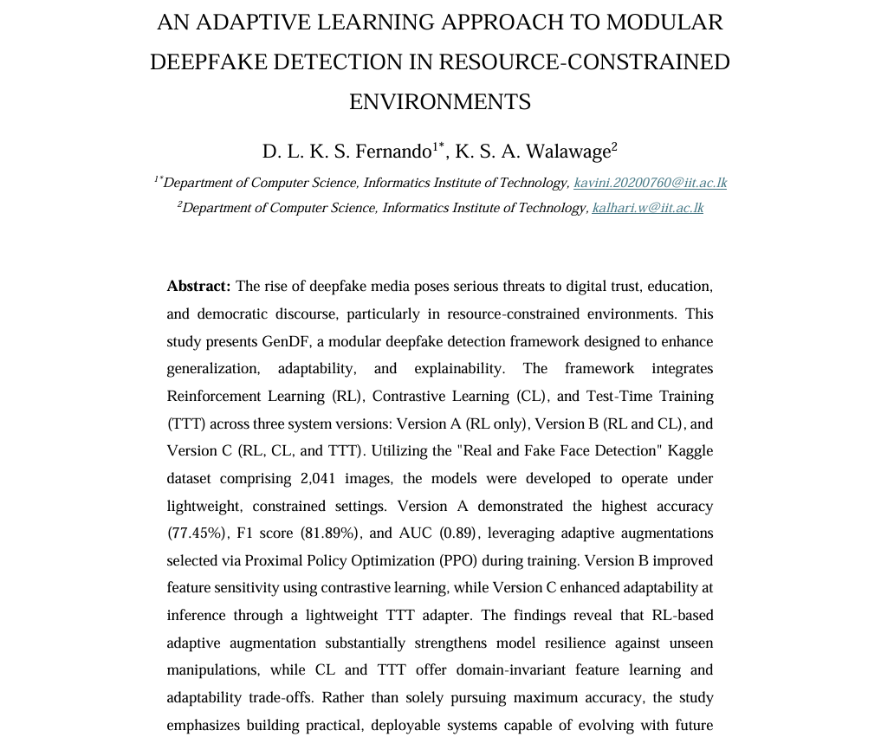
Publication
Abstract based on GenDF accepted at IRCE 2025; extended abstract paper currently under review

Slide 21
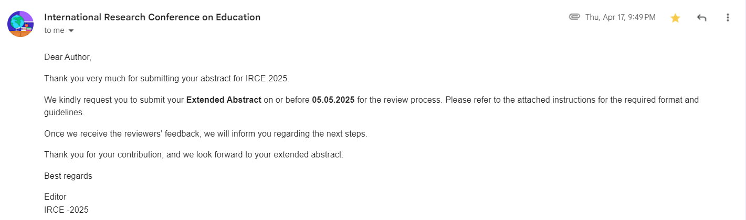
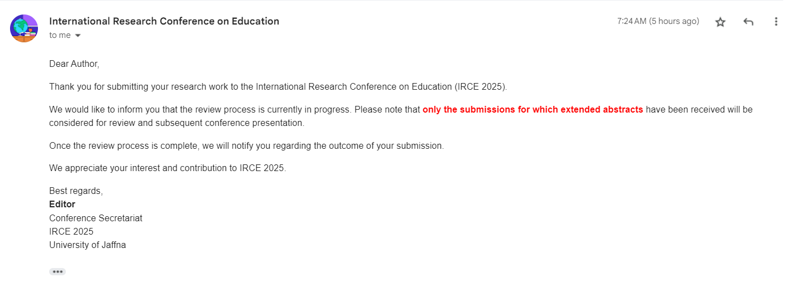
Publication

Slide 22
SUMMARY
• DEVELOPED GENDF: A MODULAR FRAMEWORK FOR DEEPFAKE DETECTION
• EVALUATED THREE LEARNING STRATEGIES: RL, CL, AND TTT
• DEMONSTRATED THE IMPACT OF EACH ON GENERALIZATION AND ADAPTABILITY
• BALANCED PERFORMANCE AND EXPLAINABILITY THROUGH STRUCTURED TESTING
• VALIDATED THE PRACTICALITY OF MODULAR AI DESIGN UNDER REAL-WORLD CONSTRAINTS

